Slide 1

Hotel Booking Web
Team Strikers

Slide 2
Team and Contribution
Rohan Patel: Build Hotel Search page and APIs
Zi Shun Yang: Build Backend-APIs
Govinder Somal: Build Customer-related pages, prepare Project Journal
Allen Wu: Build Homepage and Employee-related pages, prepare Project Journal, Sprint Task, and Project Board

Slide 3
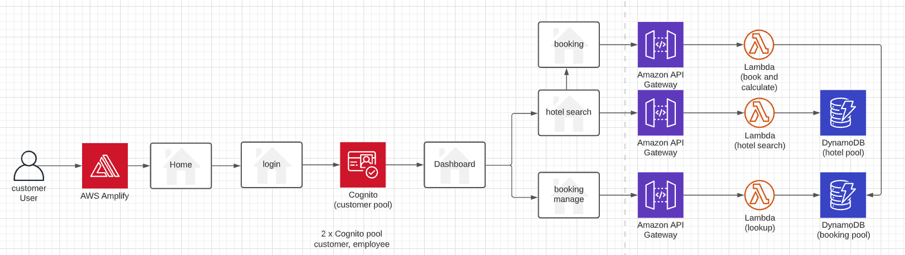
Project Architecture

Slide 4
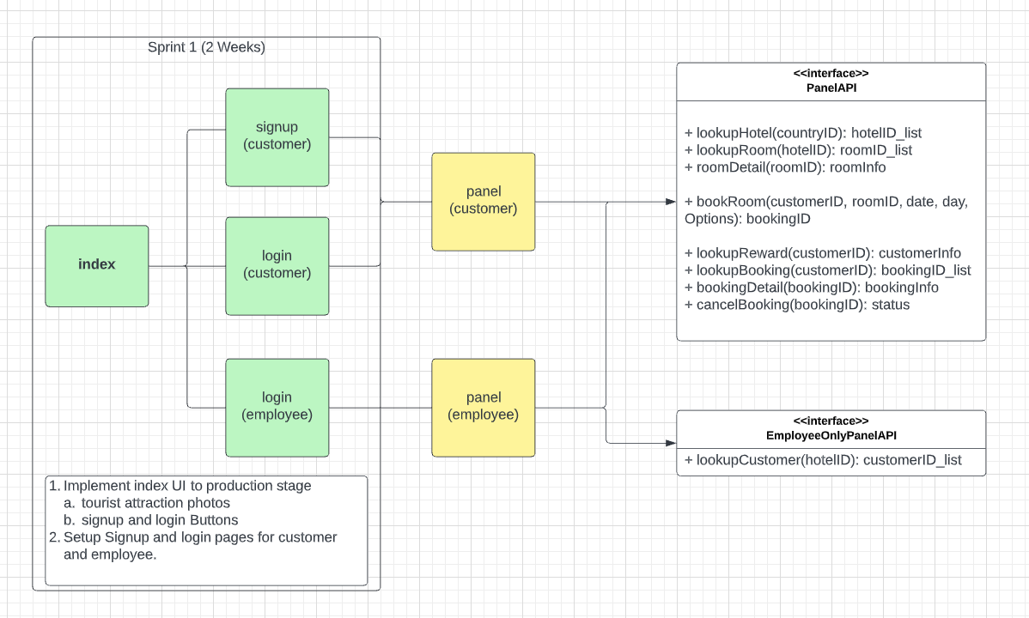
Detail

Slide 5
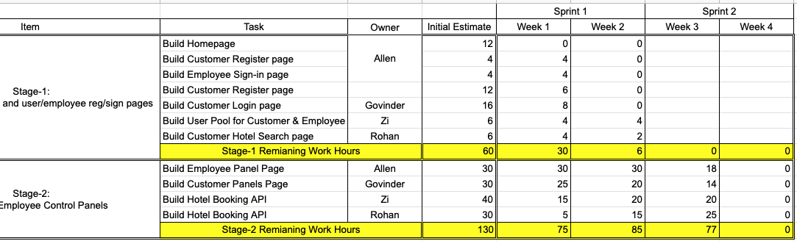
Scrum Task

Slide 6
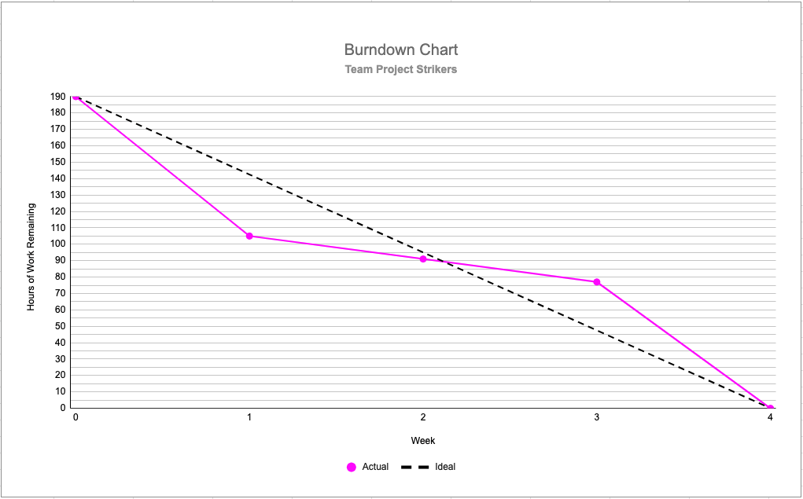
Burndown Chart

